Slide 1
Kentucky Heart Disease and Stroke Prevention Task Force Heart Systems of Care Breakout Session May 26, 2021
Chair: Nathan Kusterer, MD
Co-Chairs: Lindsay Lewis, BSN, RN and Megan Switzer, MSN, APRN

Slide 2
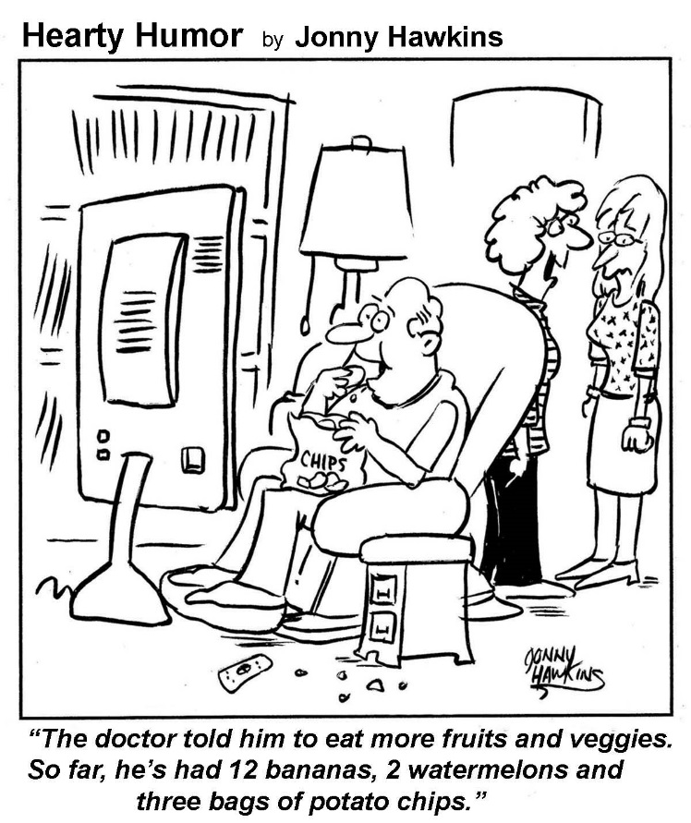
Risk Factors: KY and US

Slide 3
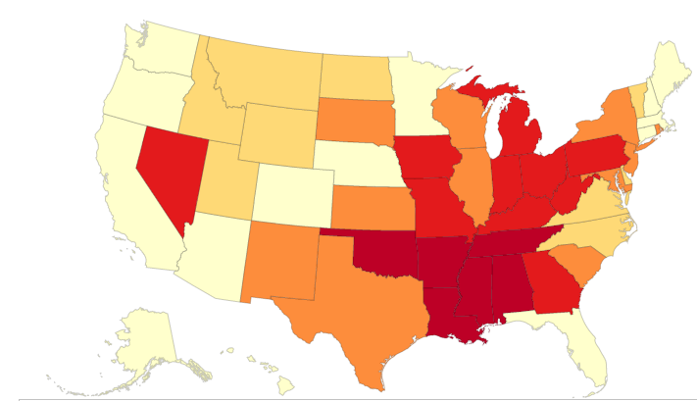
Heart Disease Mortality by State- 2019

Slide 4
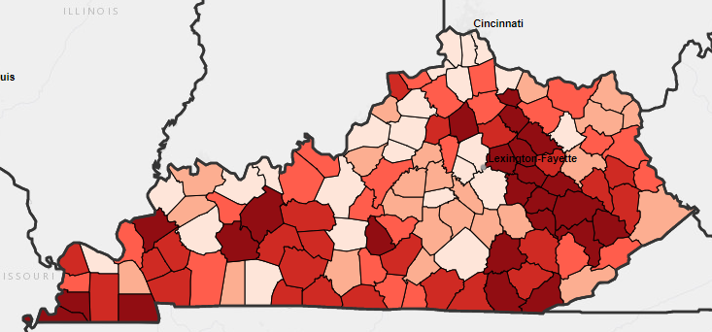
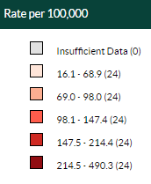
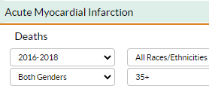
KY AMI Deaths: 2016-2018

Slide 5
https://chfs.ky.gov/agencies/dph/dpqi/cdpb/Pages/heartdiseasestroke.aspx

Slide 6
https://chfs.ky.gov/agencies/dph/dpqi/cdpb/Pages/heartdiseasestroke.aspx

Slide 7
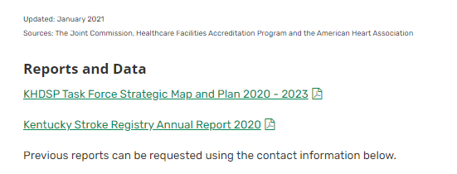
https://chfs.ky.gov/agencies/dph/dpqi/cdpb/Pages/heartdiseasestroke.aspx

Slide 8
Kentucky Heart Disease and Stroke Prevention Program
Bonita A. Bobo, RN, HHS
Program Manager
502-564-7996, Ext. 4436
bonitaa.bobo@ky.gov
Lonna Boisseau
Task Force Coordinator
502-564-7996, Ext. 4445
lonna.boisseau@ky.gov
David Davis
Communications Coordinator
502-564-7996, Ext. 4400
david.davis2@ky.gov
Christen Walker
Health Program Administrator
502-564-7996, Ext. 4445
christen.walker@ky.gov
Sheryl Meador
Administrative Assistant
502-564-7996, Ext. 4439
sheryl.meador@ky.gov
Notes:
Let’s have a few introductions before we get started. Gina Brien will be the new chair for KASH and will be helping with the facilitation of this breakout session. (Gina introduced)

Slide 9
KY Heart Disease and Stroke Prevention Task Force
Our Mission
Improved cardiovascular and cerebrovascular health for all Kentuckians
Our Goals
Utilization of evidenced-based strategies
Utilization of evidenced-based integrated cerebrovascular and cardiovascular health delivery systems
Secure policy, systems and environmental changes to improve the cerebrovascular and cardiovascular health of Kentuckians

Slide 10
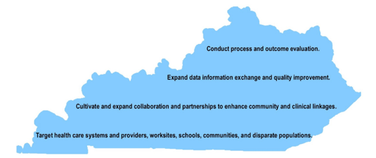
Mission Improved cardiovascular and cerebrovascular health for all Kentuckians
Overarching Strategies

Slide 11
KHDSP Task Force Structure
Two Chairs
Dr. Kerri Remmel, MD, University of Louisville, Neurology
Dr. Nathan Kusterer, MD, Baptist Health Lexington, Cardiology
Steering Committee - the governing structure of the Task Force is comprised of
Task Force Committee Chairs
Representatives from HDSP Program
Representatives from AHA and AHSA
Representatives from Kentucky EMS or EMS liaison
Committees- meet at least twice a year during biannual KHDSP Task Force meeting
Advocacy
Kentucky Against Stroke and Heart Disease (KASH)
Heart Systems of Care
Stroke Encounter Quality Improvement Project (SEQIP)

Slide 12
Heart Systems of Care

Slide 13
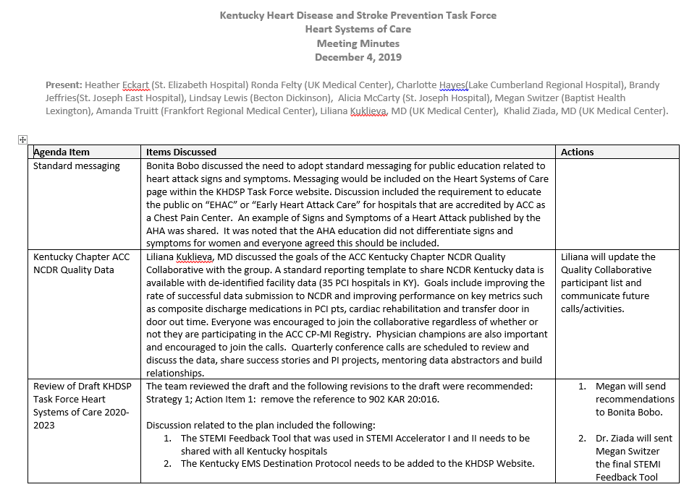
Last Meeting Dec 4, 2019 (PRE-COVID)

Slide 14
Last Meeting Dec 4, 2019 (PRE-COVID)

Slide 15
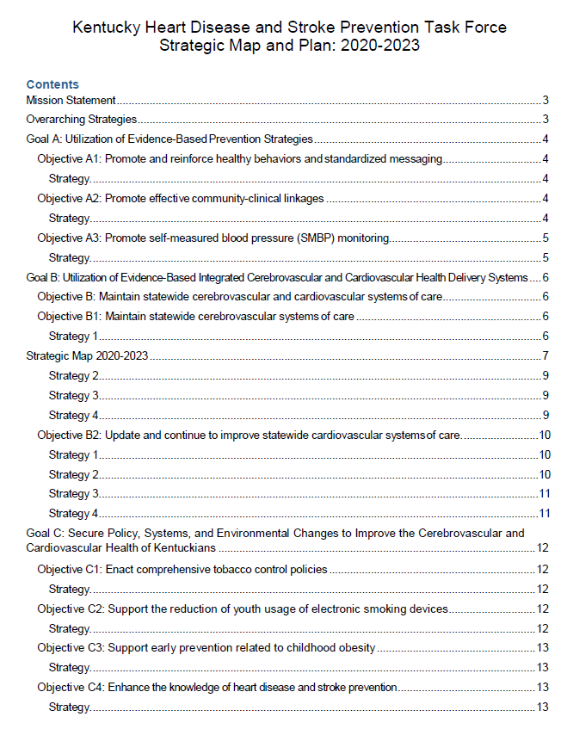
Strategic Map and Plan: 2020-2023

Slide 16
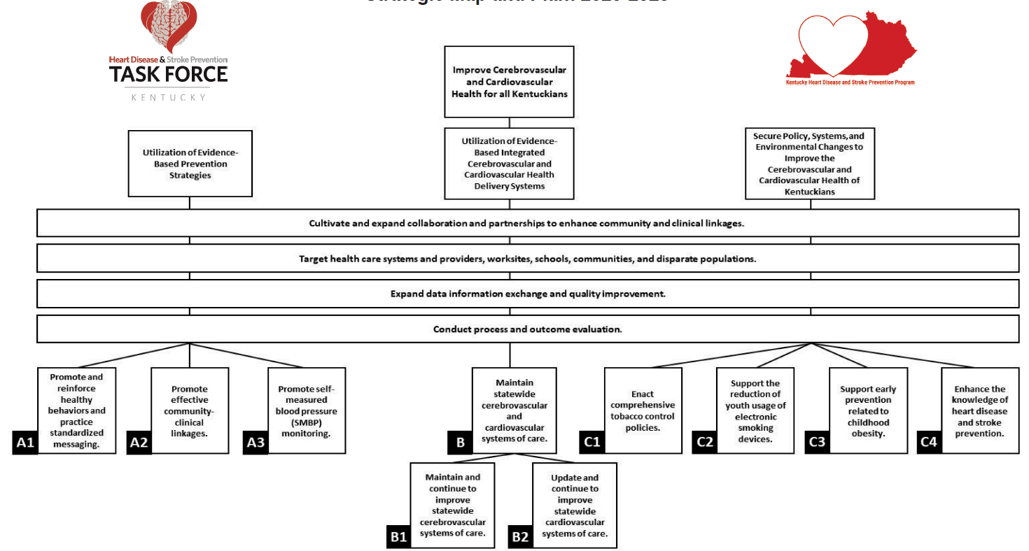
Kentucky Heart Disease and Stroke Prevention Task Force Strategic Map and Plan: 2020-2023

Slide 17
Utilization of Evidence-Based Integrated Cerebrovascular and Cardiovascular Health Delivery Systems
Improve Cerebrovascular and Cardiovascular Health for All Kentuckians
Cultivate and expand collaboration and partnerships to enhance community-clinical linkages.
Target health care systems and providers, worksites, schools, communities, and disparate populations.
.
Expand data information exchange and quality improvement
Conduct process and outcome evaluation
Maintain statewide cerebrovascular and cardiovascular
systems of care
B
Maintain and continue to improve statewide
CEREBROVASCULAR
systems of care
Update and continue to improve statewide
CARDIOVASCULAR
systems of care
B3
B2
Notes:
*** DON’T MOVE ANYTHING ON THIS SLIDE!!!!! – it is a combination of images and text boxes, not one cohesive unit. It will not move around easily.

Slide 18
How do we do that?

Slide 20
Objective: Update and Continue to Improve CV Systems of Care
Strategies
Identify and improve current heart systems of care
Engage receiving hospitals to work with its referral base to improve outcomes
Continue collaboration among healthcare systems and public health to standardize messaging
Continue to engage EMS in heart systems of care

Slide 21
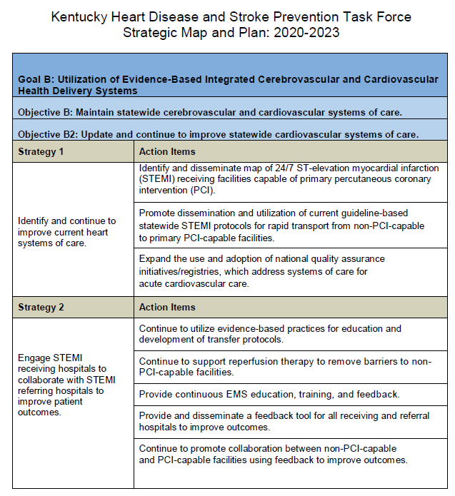

Slide 22
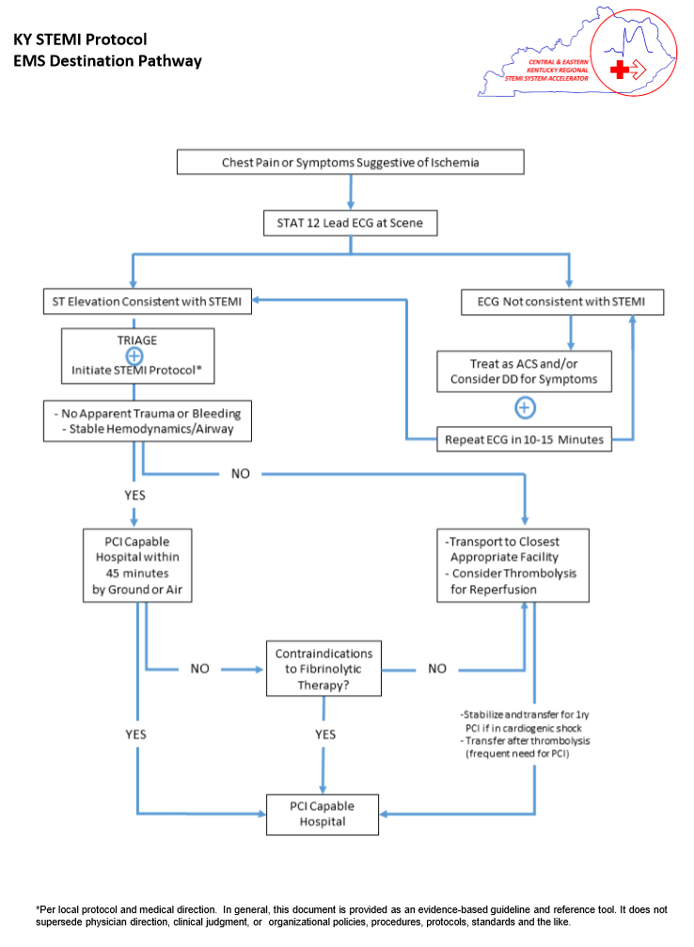
KBEMS Approved

Slide 23
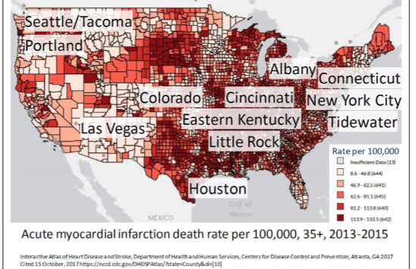
STEMI Accelerator-2 Regions
Participating hospitals in STEMI Accelerator II
A STEMI protocol was approved and used in STEMI Accelerator II project

Slide 24
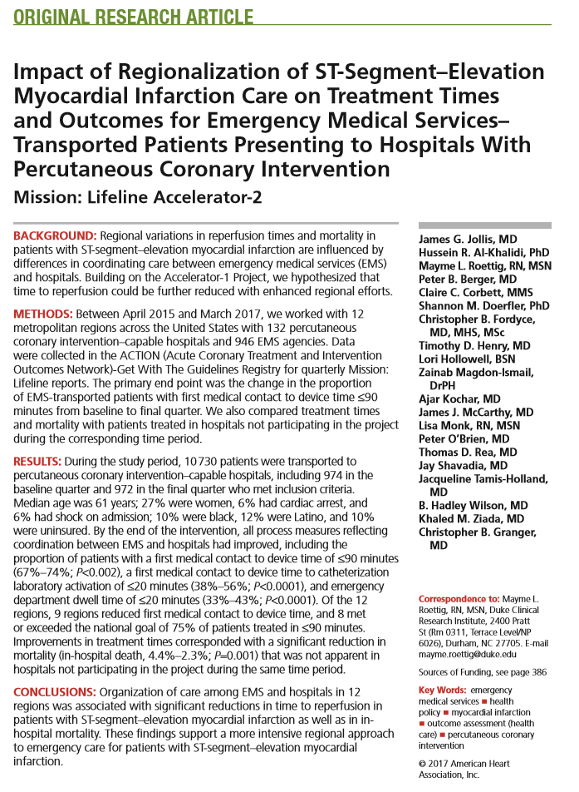
STEMI Accelerator 2
“…The most important finding of this study is that coordinated care between EMS and hospitals on the regional level led to statistically significant reductions in treatment times”

Slide 25
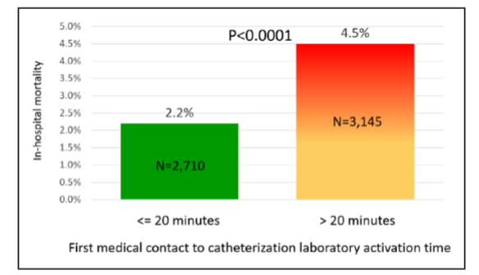
STEMI Accelerator II Results: FMC to Cath Lab Activation Time

Slide 26
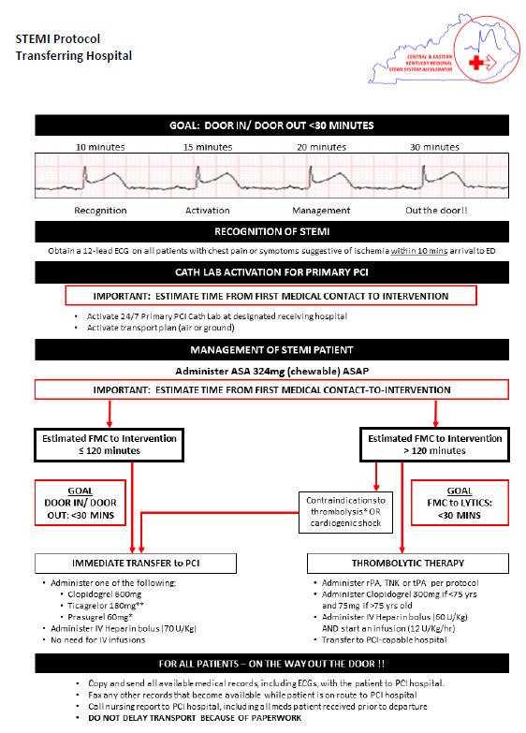
This was approved and used in STEMI Accelerator II project.

Slide 27
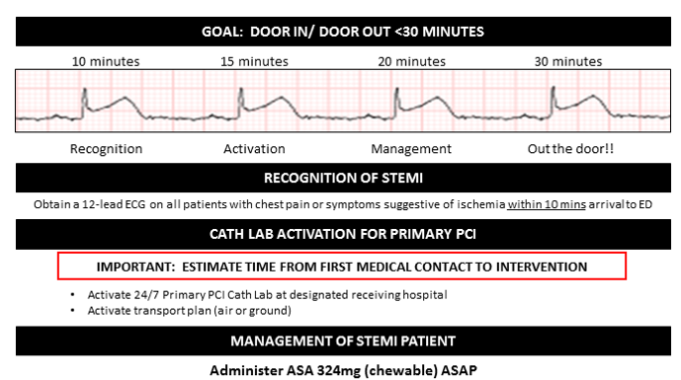

Slide 28
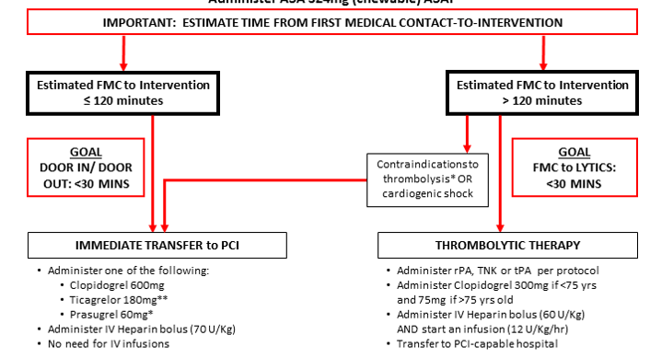

Slide 29
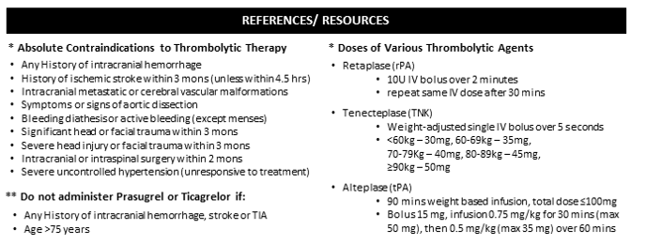

Slide 30
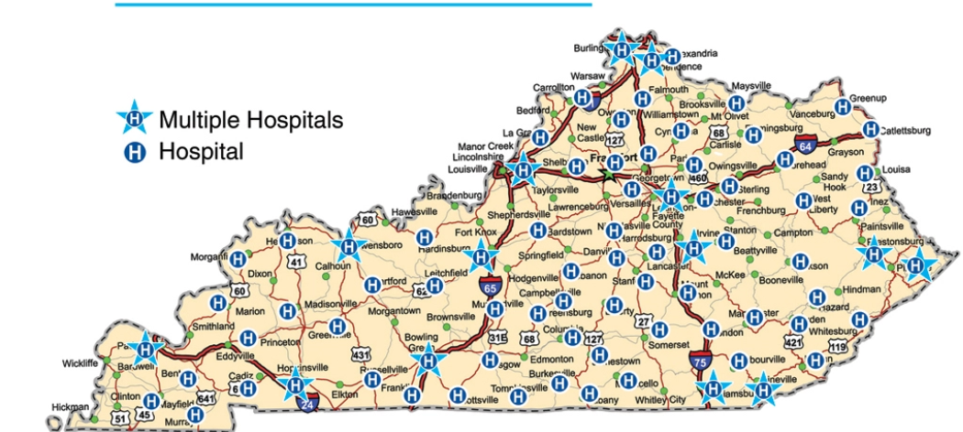
Map of Kentucky Hospitals

Slide 31
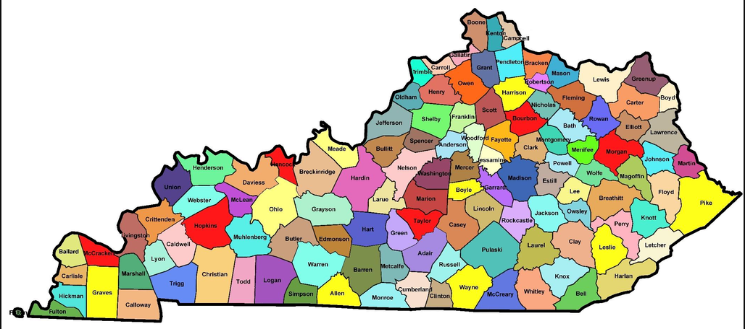
Kentucky Map of Counties

Slide 32
Objective: Update and continue to improve statewide CV systems of care
Strategy 1 | Action Items | Progress | Plan
Identify and continue to improve current heart systems of care | Identify and disseminate map of 24/7 STEMI receiving facilities capable of Primary PCI.
 | Promote dissemination and utilization of current guideline-based statewide STEMI protocols for rapid transport from non-PCI capable to primary PCI facilities.
 | Expand the use and adoption of national QA initiatives/registries, which address systems of care for acute CV care.

Slide 34
Strategy 2 | Action Items | Progress | Plan
Engage STEMI receiving hospitals to collaborate with STEMI referral hospitals to improve patient outcomes | Continue to utilize evidence-based practices for education and development of transfer protocols.
 | Continue to support reperfusion therapy to remove barriers to non-PCI facilities.
 | Provide continuous EMS education, training and feedback.
 | Provide and disseminate a feedback tool for all receiving and referral hospitals to improve outcomes.
 | Continue to promote collaboration between non-PCI capable and PCI-capable facilities using feedback to improve outcomes.

Slide 36
Strategy 3 | Action Items | Progress | Plan
Continue collaboration among healthcare systems and public health in the state to standardize messaging | Implement actions items from Goal A, Obj A1: Reinforce key heart disease and stroke prevention messaging by promoting and reinforce healthy behaviors and practice messaging (A1C, ETOH, BP, BP Meds, Chol, HOCPR, Overreact2Stroke, Physical Activity, S/S Heart Attack, S/S Stroke, Smoking, Sodium, Weight and Diet).
 | Continue to provide community education regarding Hands-Only CPR.
 | Continue to provide community education regarding use of AEDs.

Slide 37
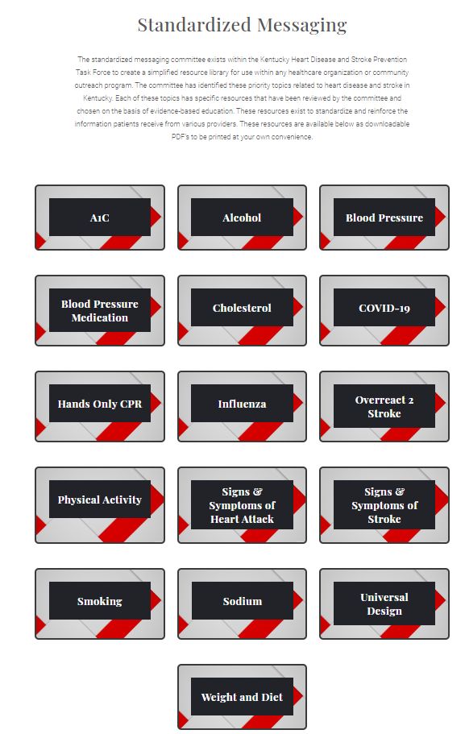
NEW WEBSITE

Slide 38
Standardized Messaging
NEW WEBSITE

Slide 40
Strategy 4 | Action Items | Progress | Plan
Continue to engage KBEMS in heart systems of care | Continue collaboration with KBEMS subcommittee, Cardiac and Stroke Care
 | Identify and support the ability to obtain pre-hospital 12-lead EKGs; collaborate with EMS agencies to obtain grants for 12-lead capabilities
 | Disseminate and provide access to current evidence-based EMD protocols

Slide 41
Kentucky Heart Disease Task Force and Stroke Prevention Website Under Construction

Slide 42
NEW WEBSITE

Slide 43
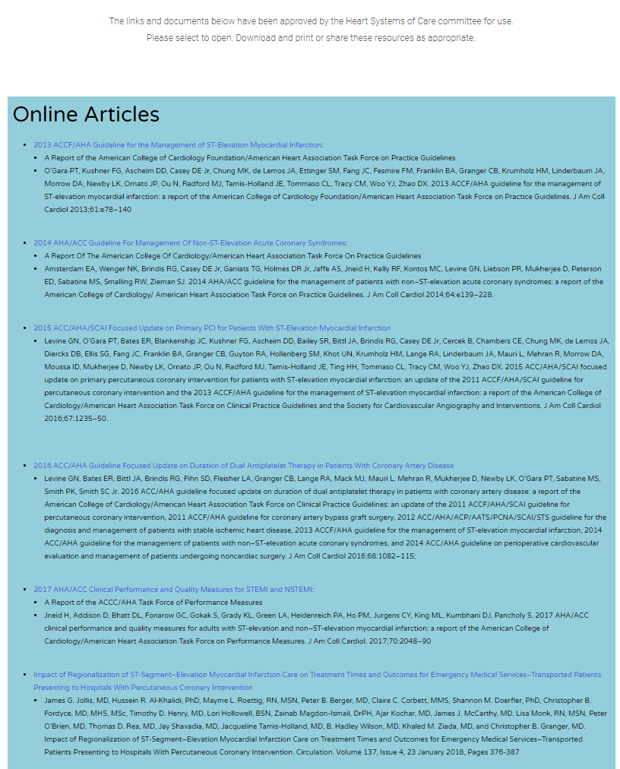
NEW WEBSITE

Slide 44
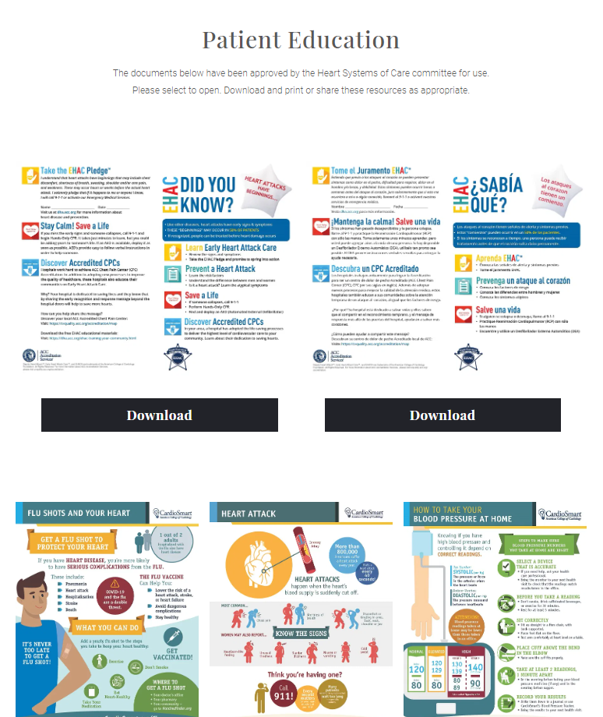
NEW WEBSITE

Slide 45
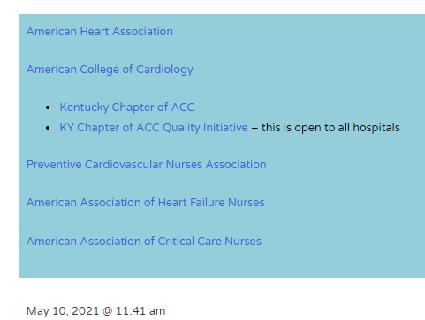
NEW WEBSITE

Slide 46
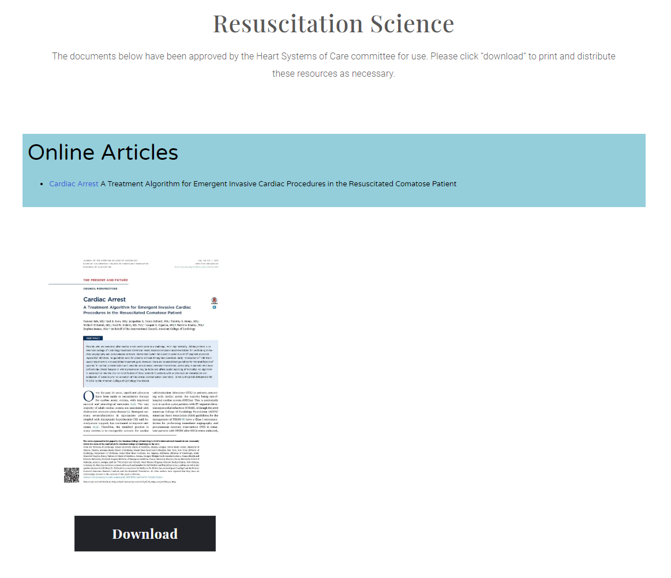
NEW WEBSITE

Slide 47
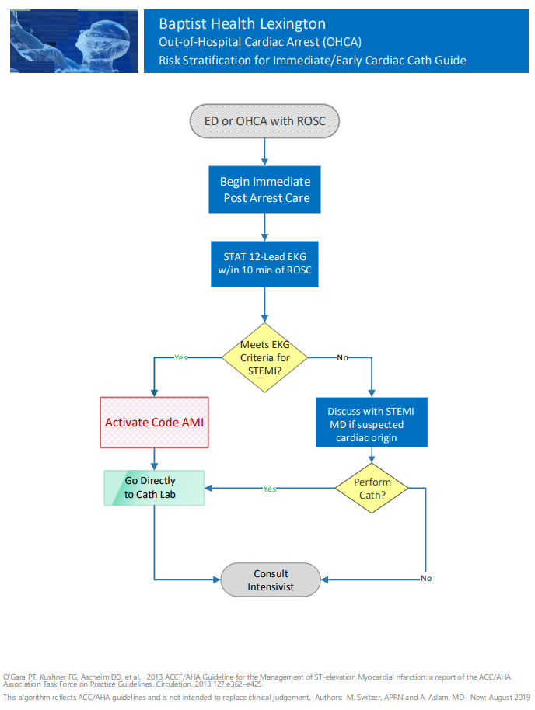
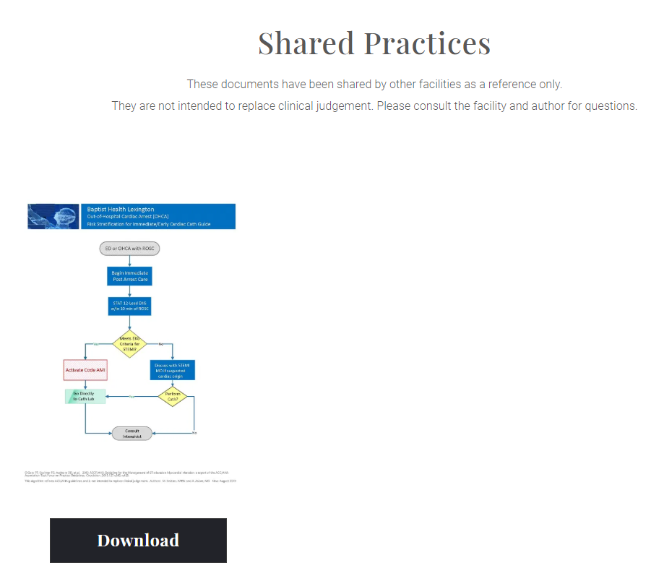
NEW WEBSITE

Slide 48
NEW WEBSITE

Slide 49
Standardized Messaging
NEW WEBSITE

Slide 50
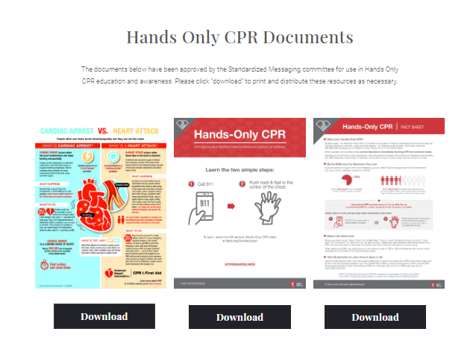
NEW WEBSITE

Slide 51
Task Talks New in 2021

Slide 52
Next Steps

Slide 54
Data Slides –Extra/Optional

Slide 55
The Journey to Thrive for Counties Among the Least Healthy

Slide 56
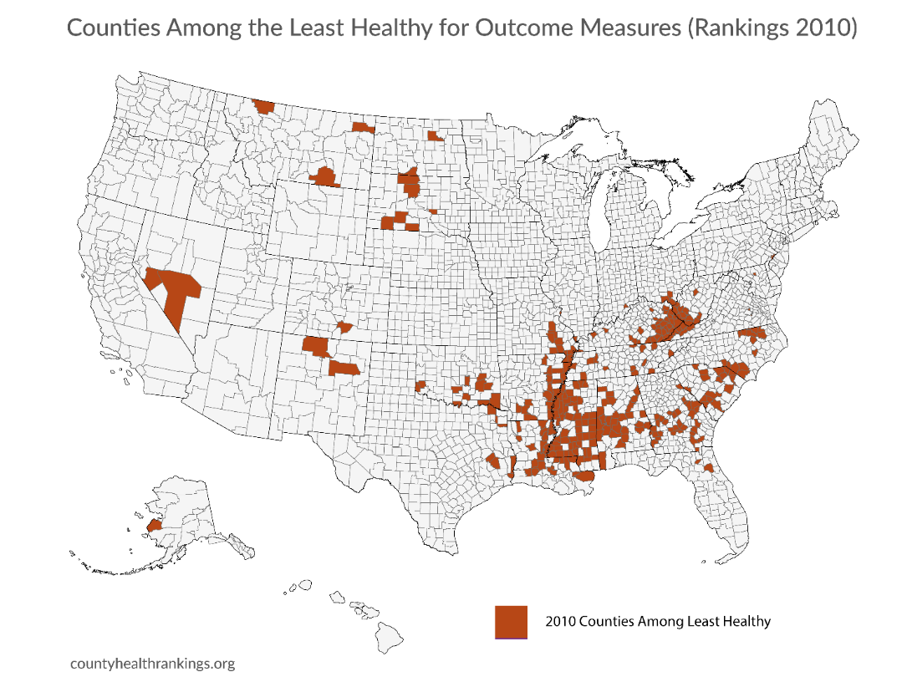
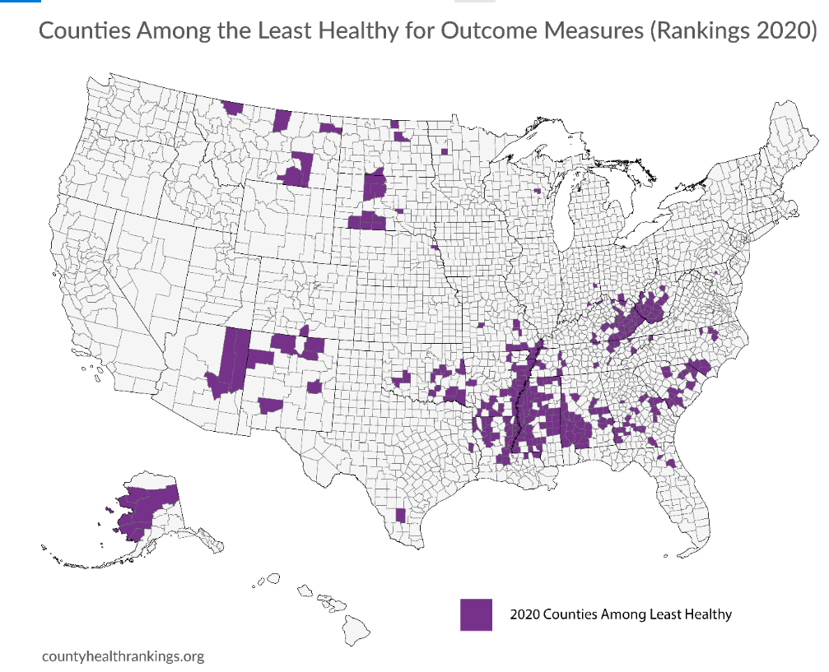
Least Healthy for Outcome Measures 2010-2020
2010
2020

Slide 57
2010
KENTUCKY Counties Among the Least Healthy for Outcome Measures
2020

Slide 58
2021 Health Outcomes- Kentucky

Slide 59
2021 Health Factors- Kentucky

Slide 60
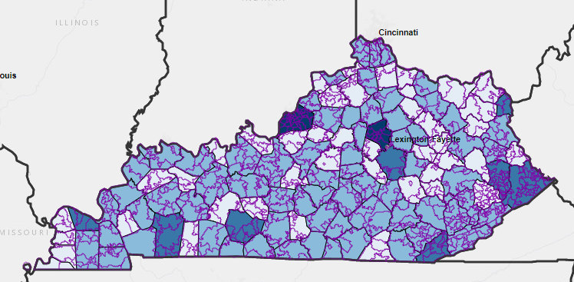
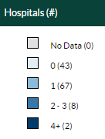
Counties with Hospitals: 2016-2018

Slide 61
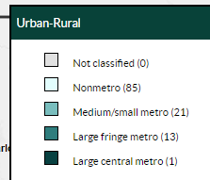
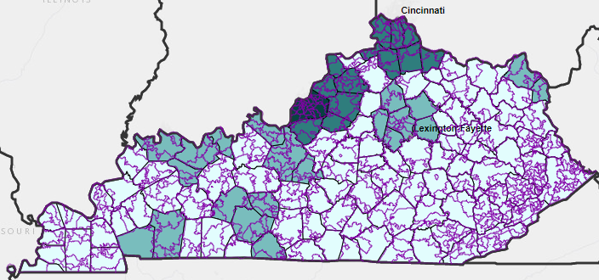
Urban-Rural Status(2016-2018)
(2016-2018)

Slide 62
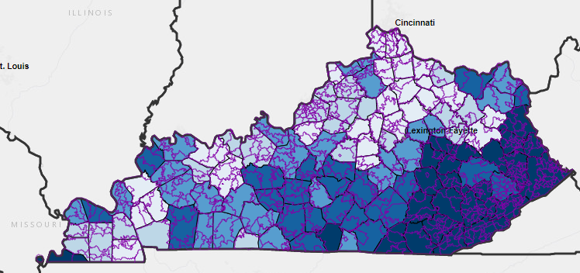
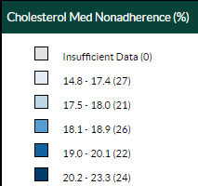
Cholesterol Nonadherence By County (2016-2018)

Slide 63
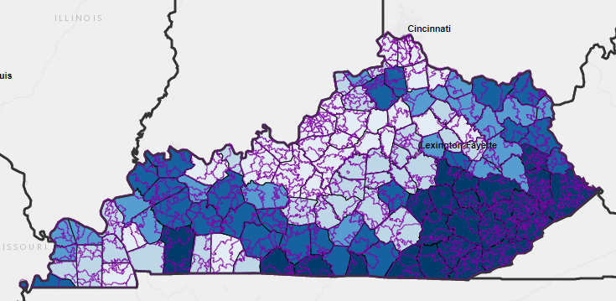
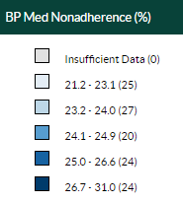
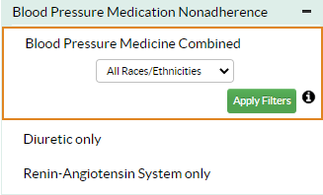
BP Med Nonadherence(%)-(2016-2018)

Slide 64
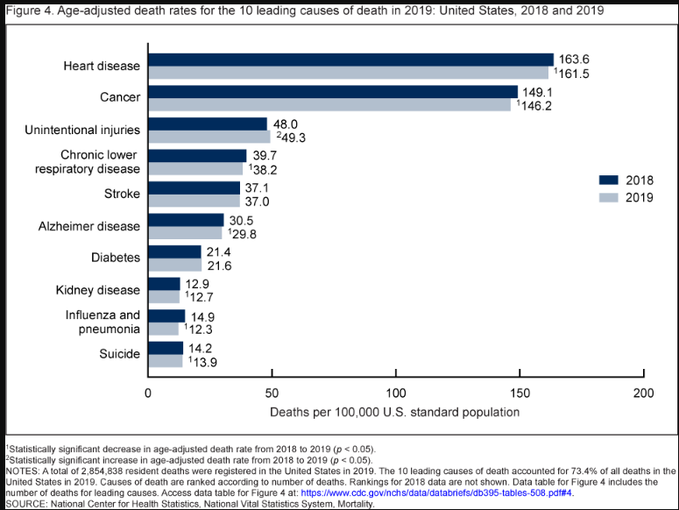
Top Ten Causes of Death in US: 2018 and 2019
https://www.cdc.gov/nchs/products/databriefs/db395.htm#section_4

Slide 65
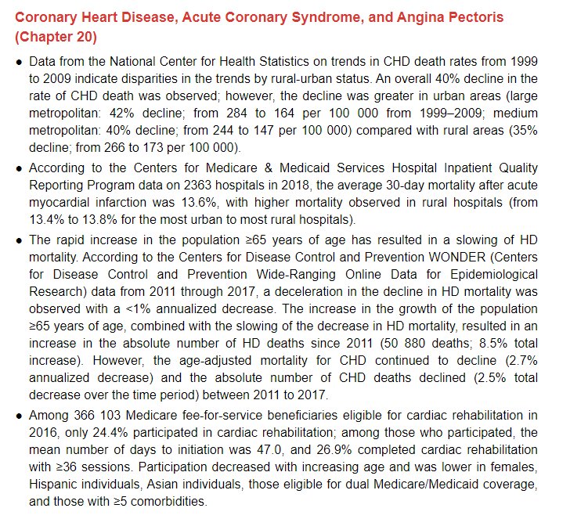

Slide 66
